Slide 1
LIC MANAGENMENT FOR LIC AGENTS..
Group Member
Anand Achha.
Pushkaraj Rokade.

Slide 2
Introduction
Agents Work - : Give Information about insurance plan to customer.
LIC company Create agent .Gives knowledge about product to agent.
Agent gives information about product to customer.
Do further things according to contract.
Gives all information to customer about their due date and maturity dates .

Slide 3
Introduction
Give Brief detail of policy to customer:
In that we gives brief detail of every plan So Agent can give best product to his Customer according to his need . And Customer can also easily understand.
Caculate Premium :
We calculate aproximatly premium .
Customer is Agree :
At that time :
We accept all details of customer and his policy.
After specific time he needs that:
We just accept detail so can contact him after some time.

Slide 4
Introduction
Save in database n gives Information about his policy:
Save Database so we can easily get all information about all customer . And some monrtary details like paid value , loans etc
Alerts:
Customer who takes policy -: we give information about due dates , matuarity dates ,death claims.
Agent profit and commission:
Gives his mothly , yearly income of agent . Which plans are doing well.

Slide 5
Software and hardware requirement
Hardware
Processor Intel 486
RAM 64 KB
HDD 2.1 GB
Floppy Drive 1.44 MB
CD-ROM 42 X

Slide 6
Software and hardware requirement
Software Requirement
Front-End Tool
Visual Basic 6.0.
Back-End Tool
MS-Access 2002-2003.
Operating System Windows98/2000/xp/Vista/Windows.

Slide 7
Forms Screen shot.

Slide 8
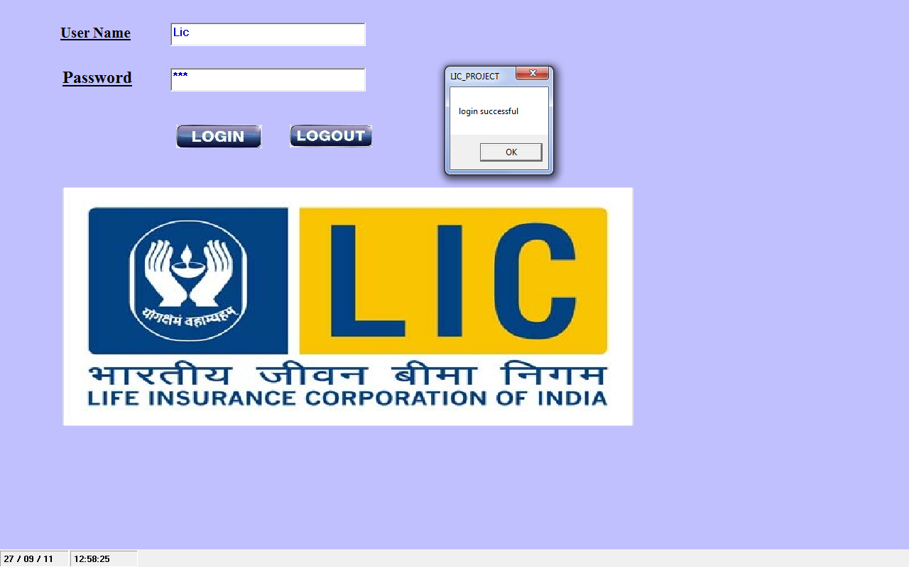
Login Form

Slide 9

Start Form

Slide 10
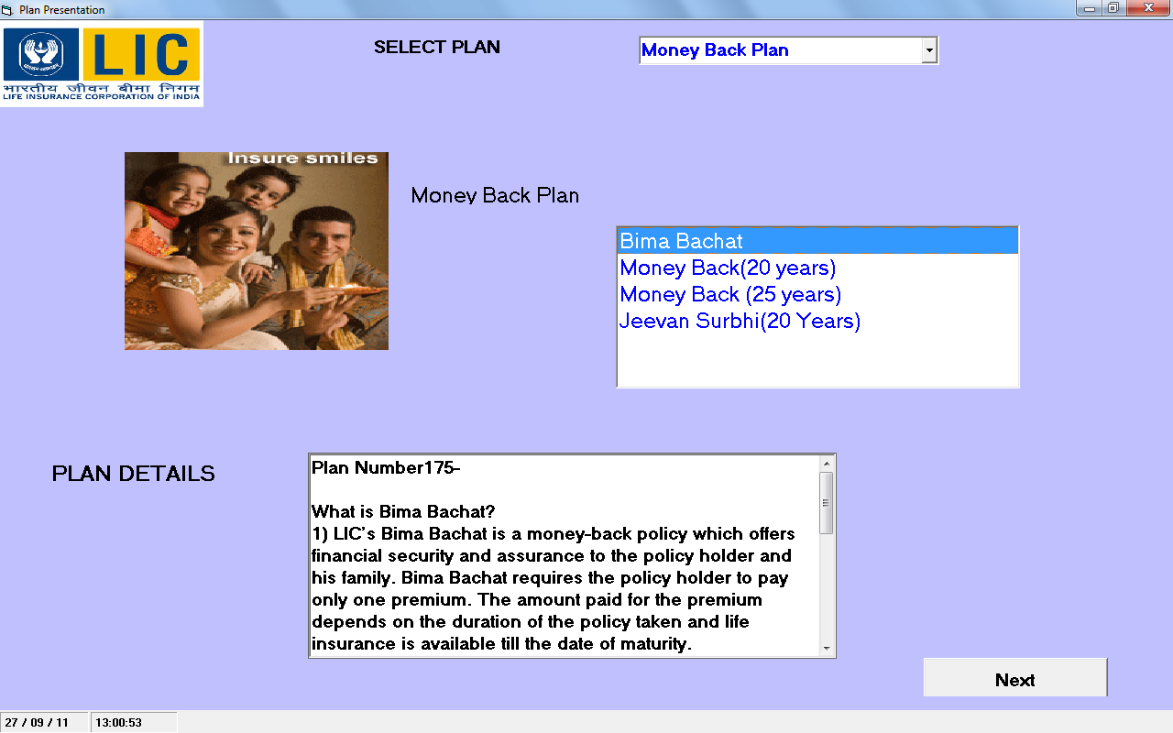
Presentation Form

Slide 11
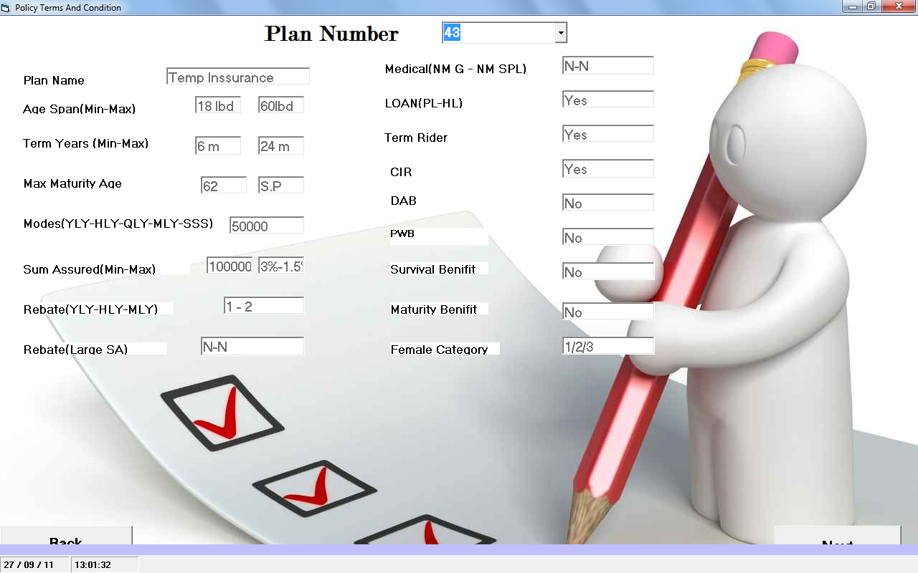
Terms And Condition Form

Slide 12
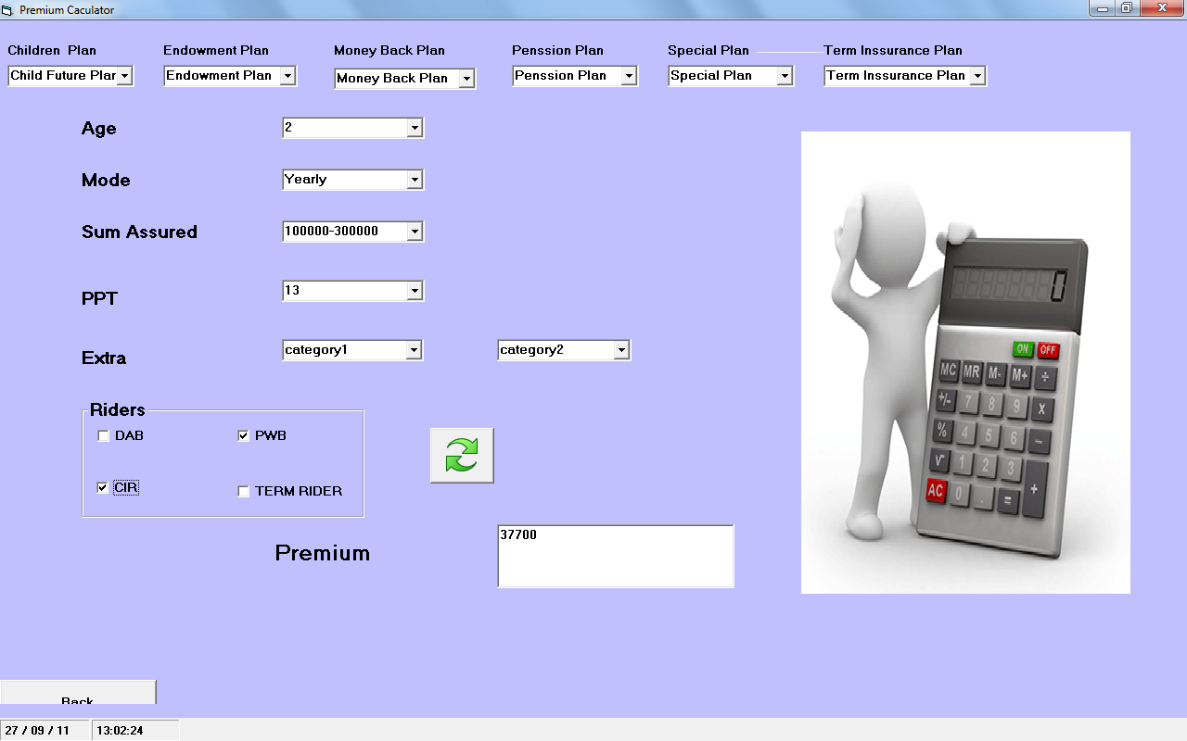
Calculator Form

Slide 13
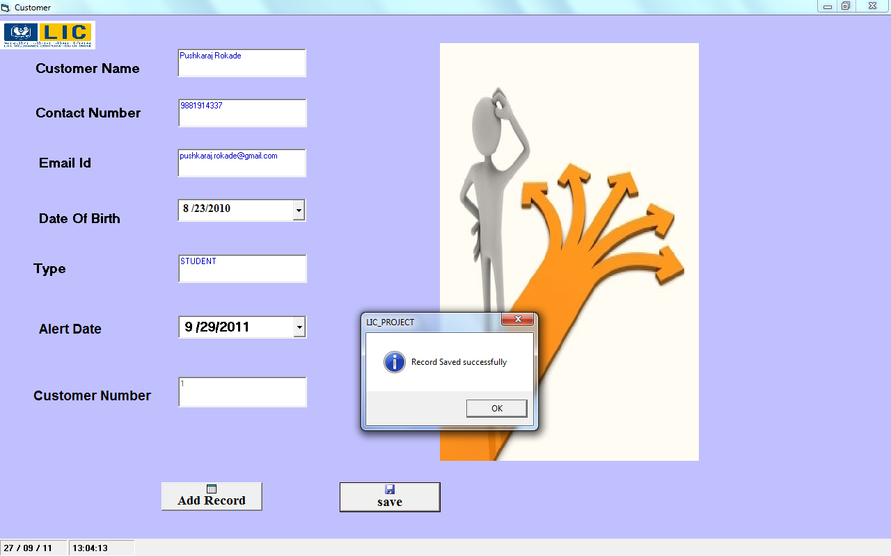
Customer Form

Slide 14
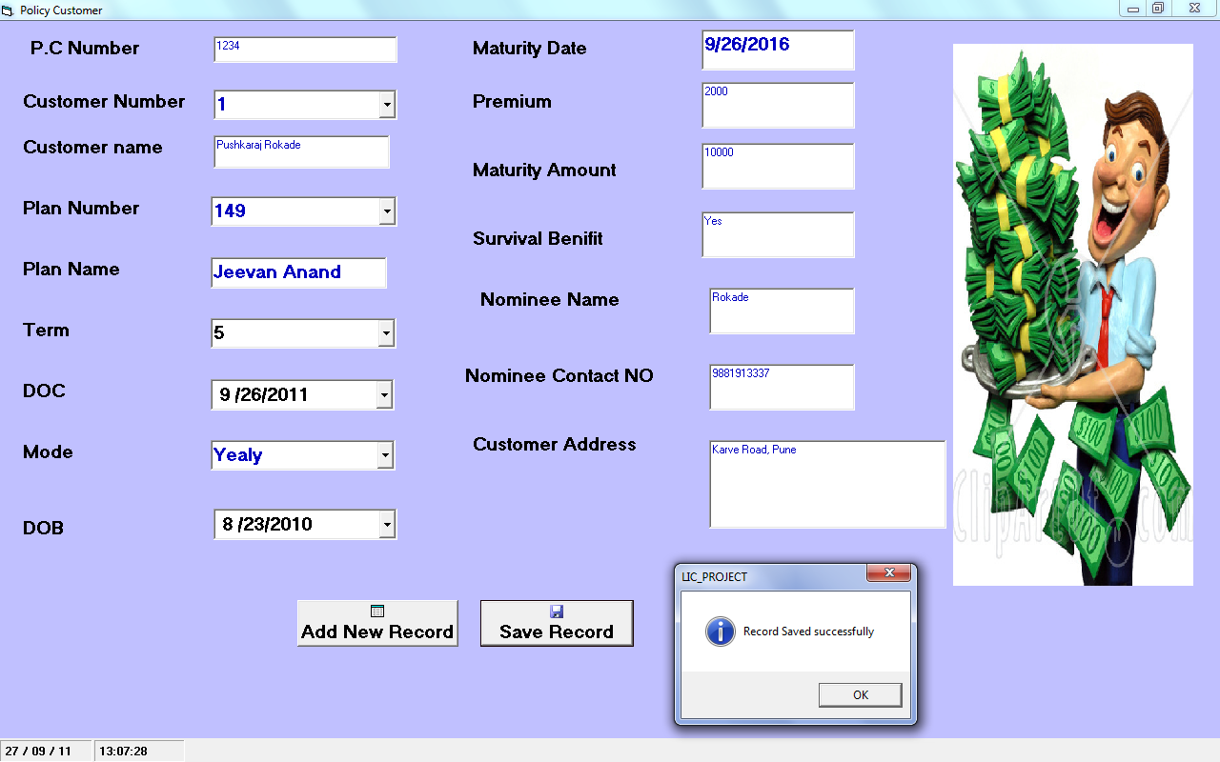
Policy Customer Form

Slide 15
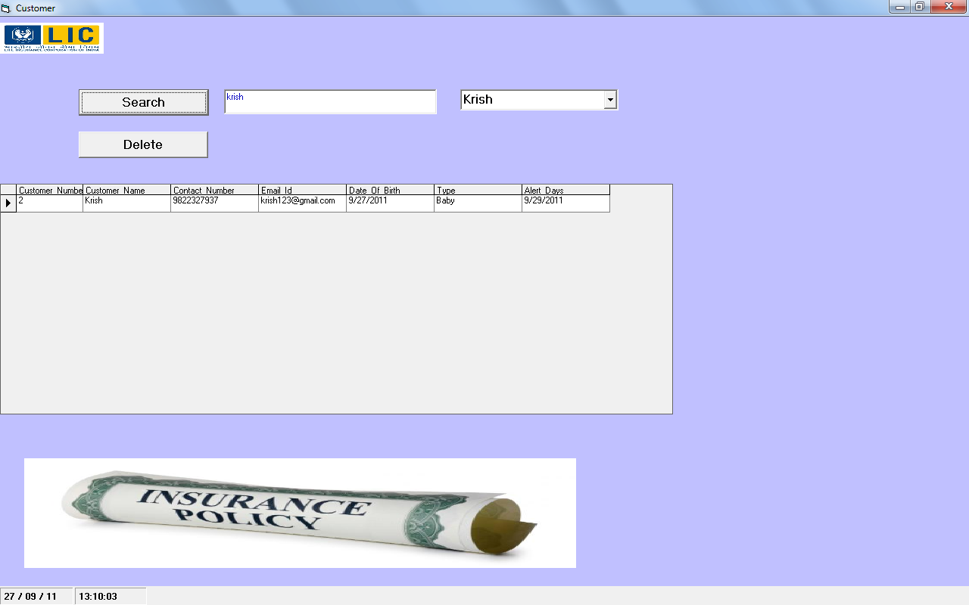
Search Form

Slide 16
Search Form

Slide 17
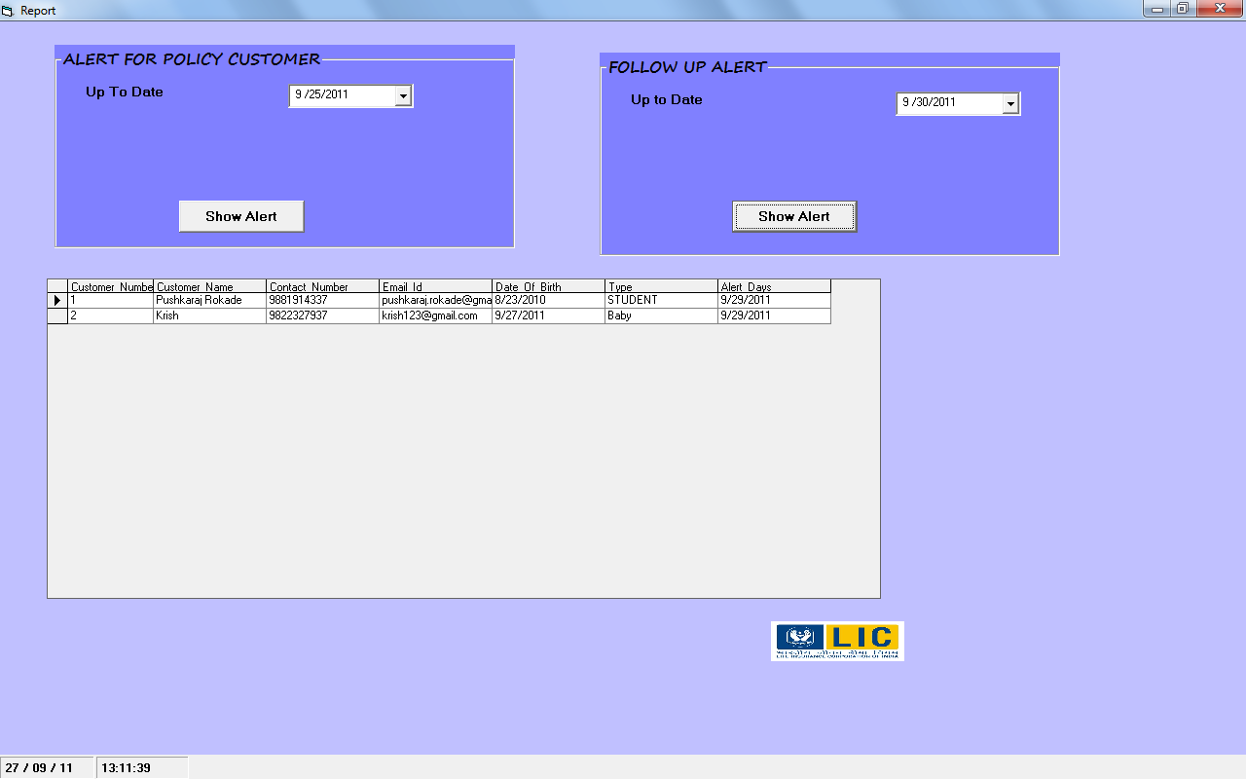
Alert Form

Slide 18
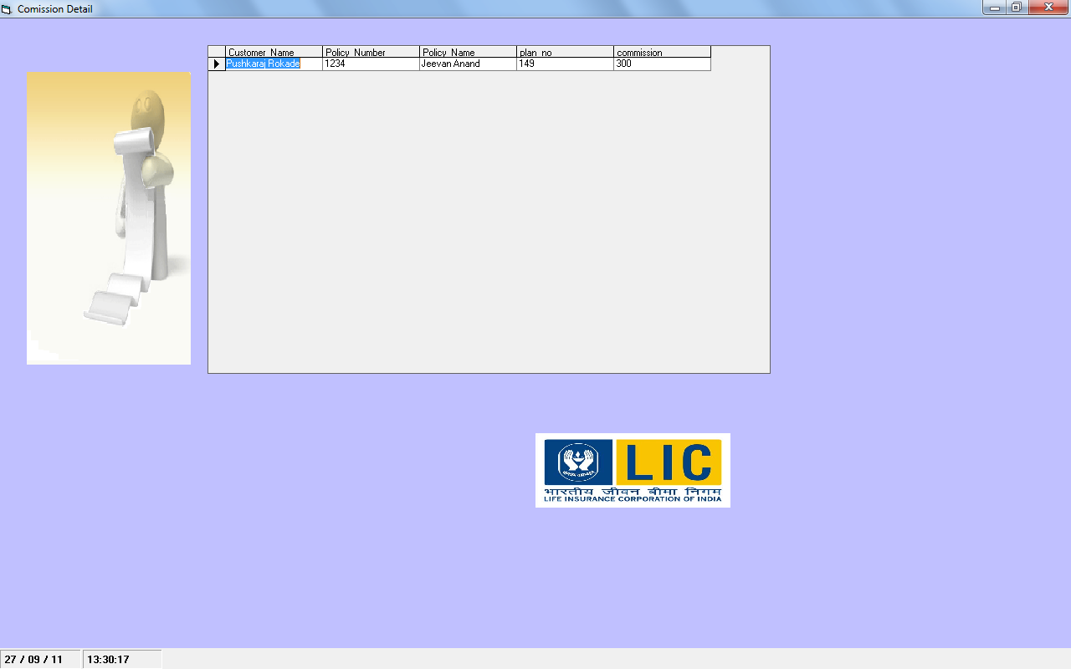
Commission Form

Slide 19
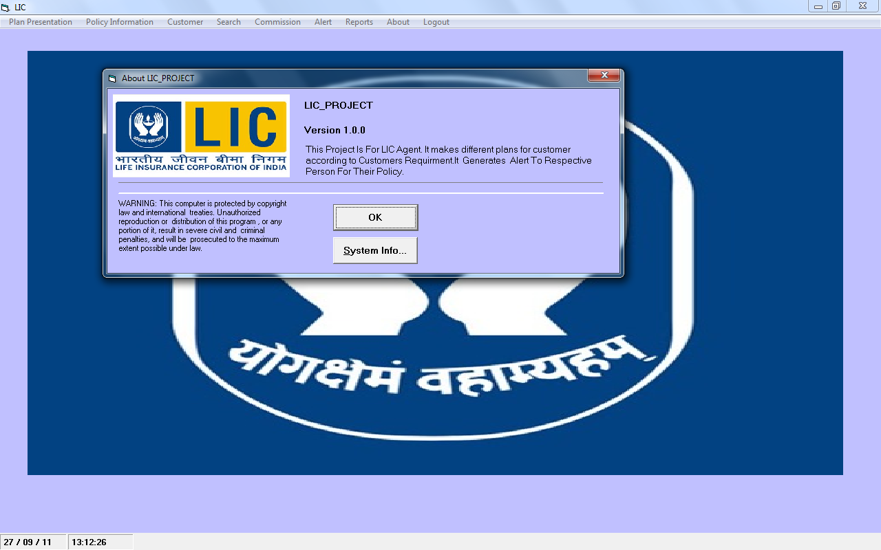
About Form

Slide 20
Reports .

Slide 21
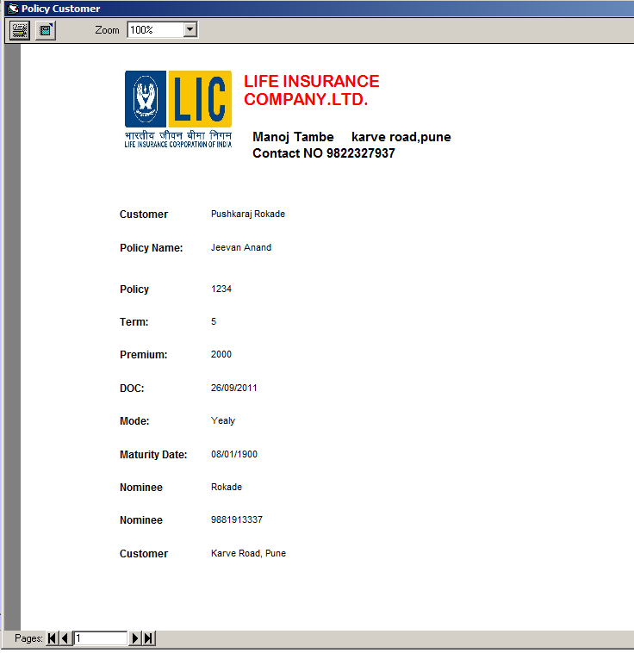
Policy Customer Information

Slide 22
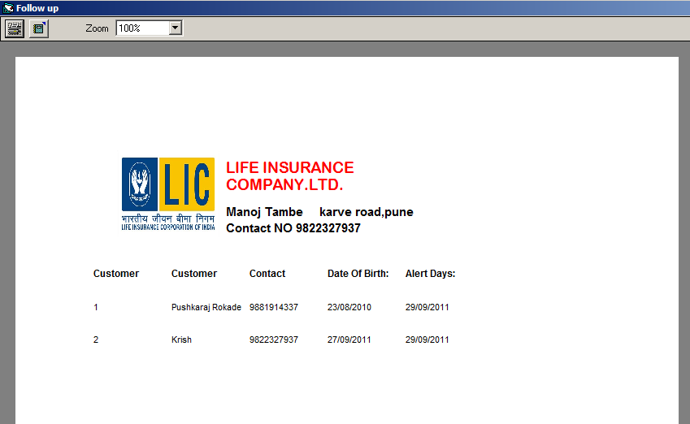
Follow Up Alerts

Slide 23
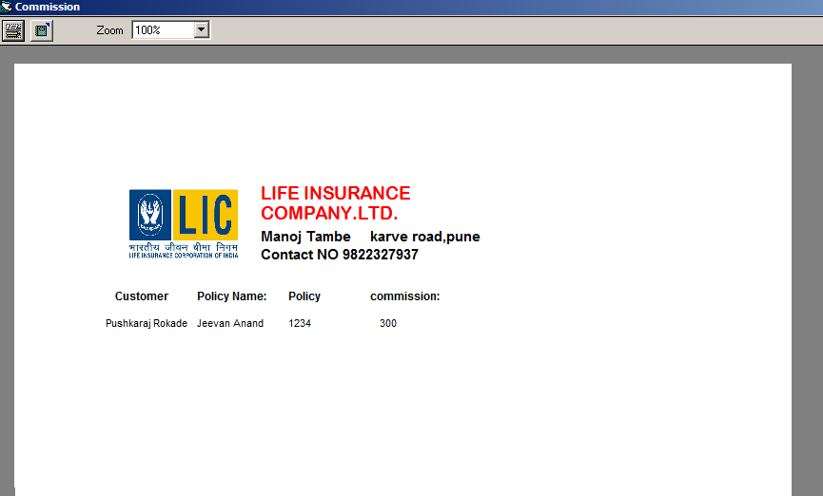
Commission

Slide 24
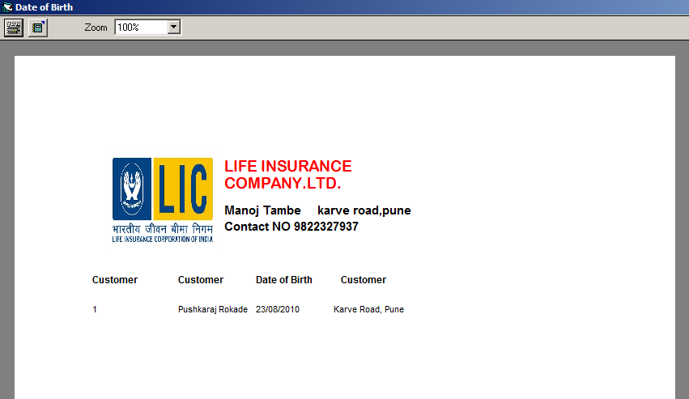
Birth Day Alert

Slide 25
Advantages & Limitations
Advantages
Reduction of paperwork
Simplifying calculations
Increasing accuracy and efficiency
Standardization of reports and other output formats

Slide 26
Advantages & Limitations
Limitations
You want to update premium table every year which is declare by LIC.
2) Stand alone system hense no multiuser environment.

Slide 27
Future Enhancement
Add more plans into System.
Give automatic alerts by mail and SMS.
Give automatic tax details of business and bank details.

Slide 28
Thank You.

